Slide 1

CSI 758 Project Kaggle Data Science Bowl 2017 Lung Cancer Detection
Bruce Goldfeder
May 4, 2017

Slide 2
Understanding the Data
Anonymized, high-resolution lung scans from hundreds of patients low-dose CT technology scans.
Three Data Sets of DICOM images
Sample set of 20 Dicom, Stage1(70GB), Stage2(40GB)
Each DICOM image had approximately 100 - 200 sub-images
2D layer of the scan – each of size [512,512] in color
Aggregated makes a 3D image
Label File with Binary of Has Cancer = 1, No Cancer = 0
Subset of patients identified to be used as training set
Number of
Sub-Images Cancer? Image Size
=====================================
134 0 (512, 512)
128 0 (512, 512)
133 0 (512, 512)
110 0 (512, 512)
203 1 (512, 512)
id | cancer
0015ceb851d7251b8f399e39779d1e7d | 1
0030a160d58723ff36d73f41b170ec21 | 0
003f41c78e6acfa92430a057ac0b306e | 0
006b96310a37b36cccb2ab48d10b49a3 | 1

Slide 3
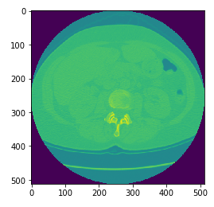
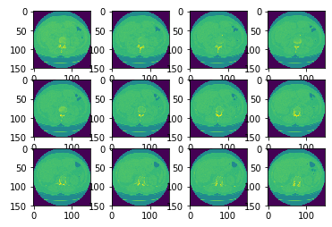
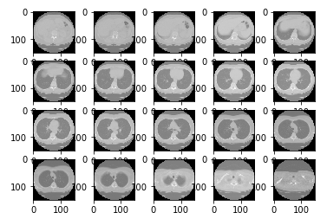
Visualizing and Conditioning the Data
Convolutional Neural Nets (CNN) use small image sizes typically 64x64 or smaller and the same number of inputs
This presents a conditioning problem in how to get [512,512] x ~200 layers into that format!!!
Techniques – Resize, Chunk Layers together to same number per Dicom using an averaging function
Original 2D Slices
Resized 2D Slices
20 “Chunks” per Dicom

Slide 4
Pre-Process Data for 3D CNN

